Slide 1
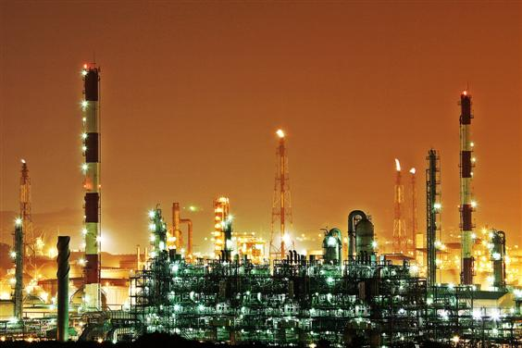


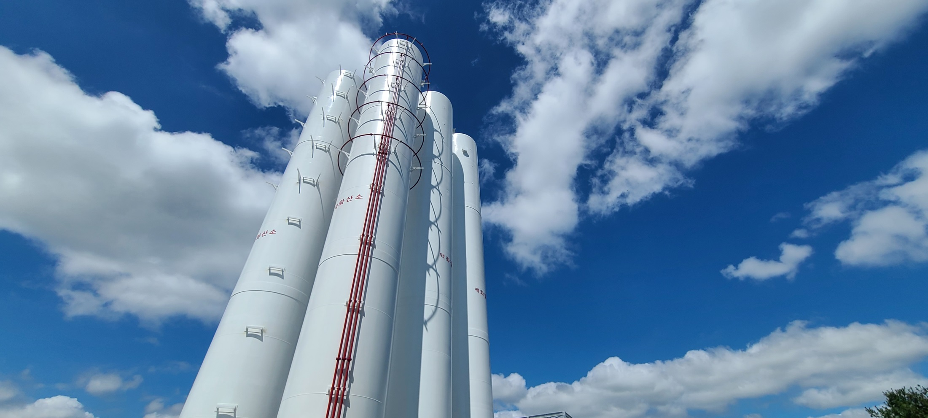
DAE RIM MACHINERY CO.,LTD.

Slide 2

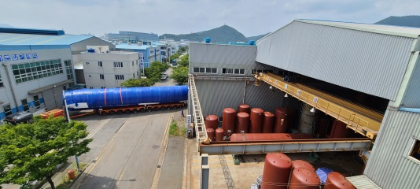
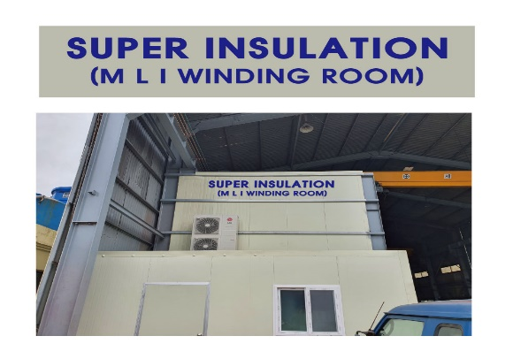
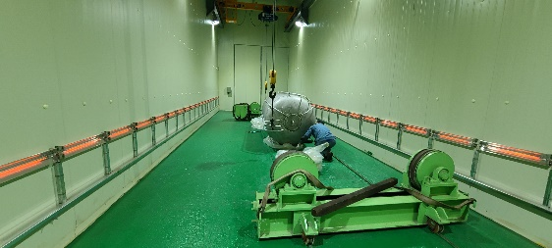

CONTENTS
Busan Factory No.1
Busan Factory No.1
General Information
History Location
Organization Chart Business Area
Major Product Certification
Production Capacity Production Allocation
Busan Factory No.2
Office
Business Information
Fabrication Capacity Major Customers Experiences
Changwon Factory No.3
Clean Room
Paint Room

Slide 3




VISION
BEST SOLUTION PROVIDER for CRYOGENIC TANK
CORE VALUE
HUMAN
CHALLANGE
INOVATION
SAFETY

Slide 4
MANAGEMENT IDEOLOGY & REQUIRED TALENTS
TRUSTED
ENGINEER
TRUSTED
COMPANY
PROFESSIONALISM
INOVATION
DAERIM
COMMUNICATION
COLLABORATION
HUMAN
US
RATHER THAN
ME
SLOGAN
Design-Further, Build Future !

Slide 5
GENERAL INFORMATION
History
1990 ~ 1999
2000 ~ 2009
2010 ~ 2019
2020 ~ Present
1990
Established
Daerim Engineering
1999
Re-Named
Daerim Machinery Co.,Ltd
2002
Registered
Special Equipment
Manufacture (Korea)
2011
Established 2nd Factory
2021
Renewal Certification
ASME U & U2
2007
Certification
ISO 9001 (Quality Control)
2012
Certified ASME U & U2
2022
Relocation of Head Office
(Currently Here)
2019
Registered
Freezer Manufacture
(Korea)
2024
Certification
ISO 14001 (Environment)
ISO 45001 (Safety)
01

Slide 6
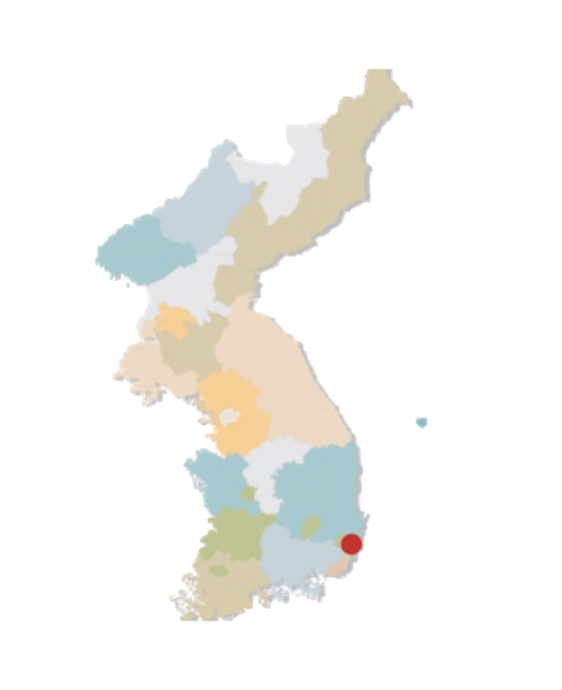

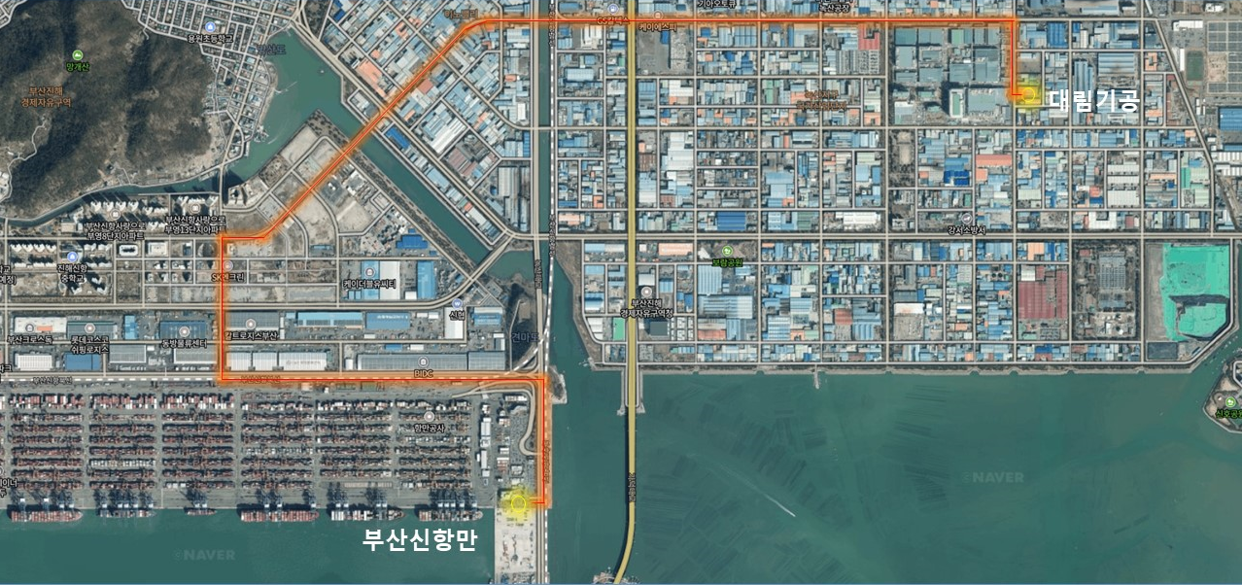
Location
GENERAL INFORMATION
Domestic Factory
Factory | Location | Space (m²)
Factory No.1 | Busan | 10,000㎡
Factory No.2 | Busan | 3,300㎡
Factory No.3 | Changwon | 2,000㎡
Grand-total |  | 15,300(4700평)
Seoul
400km
(645 Miles)
Changwon
30km
Busan
(No.3 Factory)
(No.1 Factory)
(No.2 Factory)
DAERIM
6Km from Busan New Port
Busan New Port
02

Slide 7
GENERAL INFORMATION
Organization Chart
Chairman
President
Quality
Control Div.
4 STAFF
General Affairs/
Procurement Div.
Technical
Sales Div.
Design & Eng.
Div.
Manufacturing
Div.
R&D
Center
3 STAFF(Concurrent)
3 STAFF
4 STAFF
5 STAFF
25 STAFF
(Outsourcing 10)
Total 45~50person
03

Slide 8

Business Area
GENERAL INFORMATION
Supply and Service | ITEM
Stress Analysis (Thermal,CFD) Detail Engineering (Strength Calculation, Detail Drawing) Manufacturing Inspection Service (NDE, Hydrostatic & Pneumatic Test) Site Construction & Equipment Erection Supervision Repair & Maintenance | Cryogenic Storage Tank Cryogenic Tank Lorry / Trailer LPG Tank Spherical Storage Tank Shell & Tube Heat Exchanger Pressure Vessel Reactor Head Forming & Shell/Cone Rolling Steel Structure & others
04

Slide 9
Major Product
GENERAL INFORMATION
Cryogenic Storage Tank | Cryogenic Tank Lorry/Trailer
LO2, LN2, LAr Storage Tank LCO2, LN2O Storage Tank LNG Storage Tank LC2H4 Storage Tank L-H2 Storage Tank Flat-Bottom Dome-Roof Tank | (Perlite/MLI Insulated with Vacuum) Cryogenic Tank Lorry / Trailer LO2, LN2, Lar Lorry/Trailer LCO2, LN2O Lorry/Trailer LNG Tank Trailer LC2H4 Tank Trailer Cryogenic ISO Container
05

Slide 10
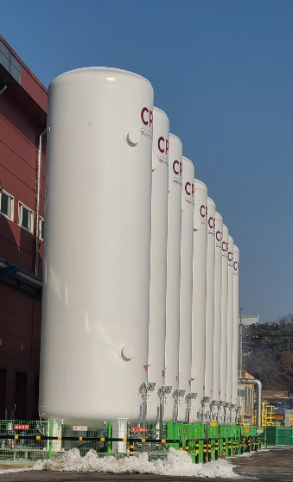
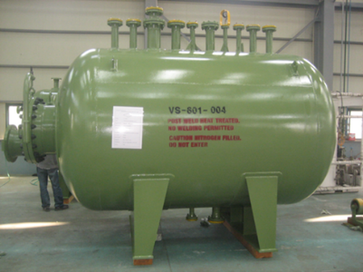
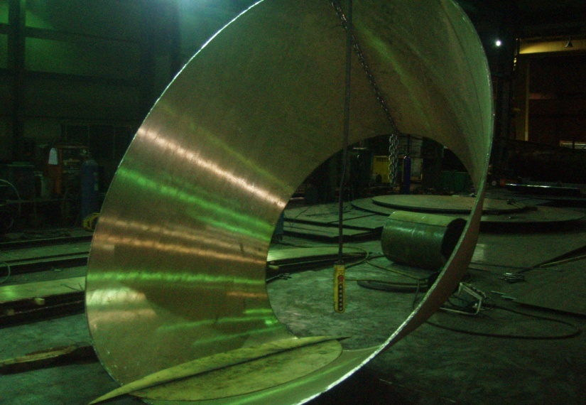
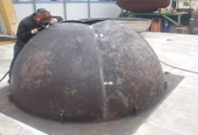
Major Product
GENERAL INFORMATION
Cryogenic Tank
Pressure Vessel
LOX, LIN, LNG, L-H2
LCO2, LN2O, L-C2H4
Spherical Storage Tank
Heat Exchanger
Pressure Vessels
(Reactor, Condenser etc.)
Autoclave
Head forming & Bending
Roll Bendig
Cone Rolling
Structure Bending
Spherical Pressing
Head Spinning
Segment Pressing
06

Slide 11
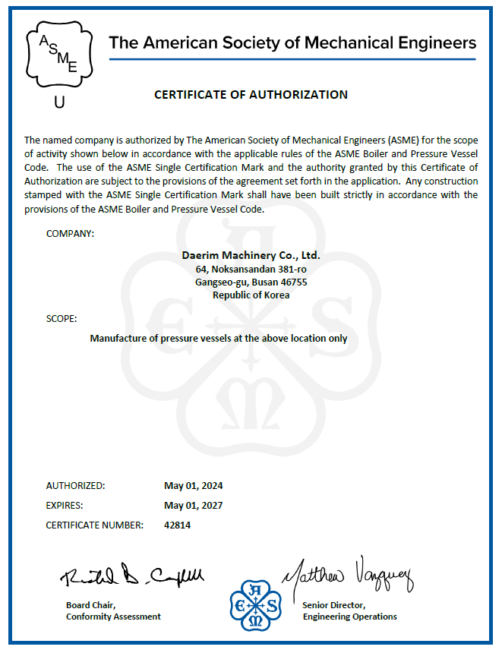
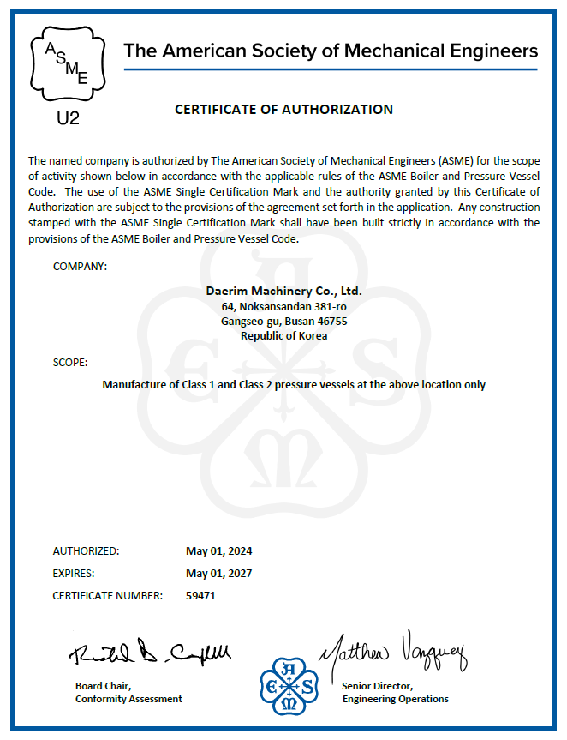
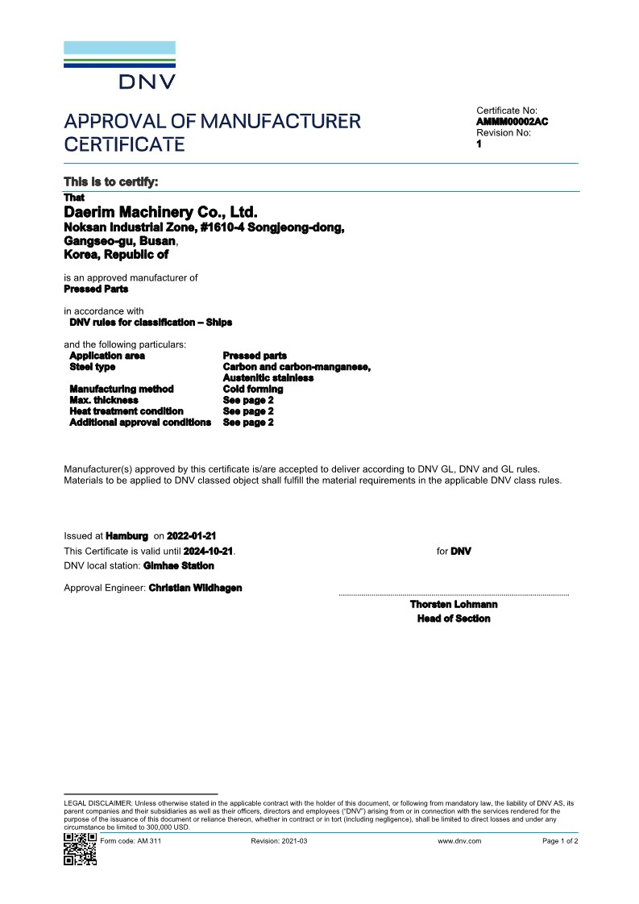
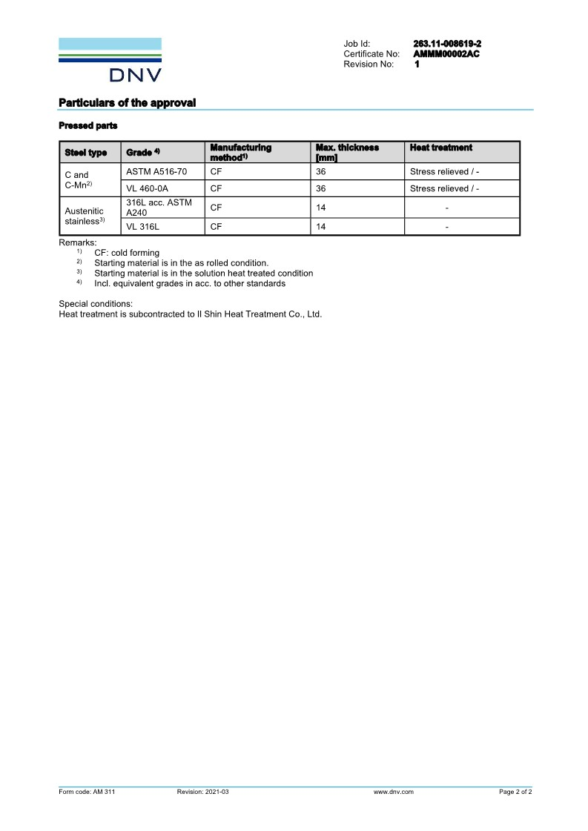
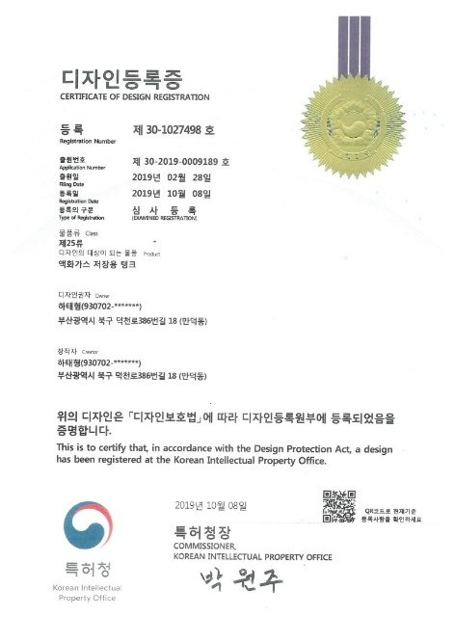
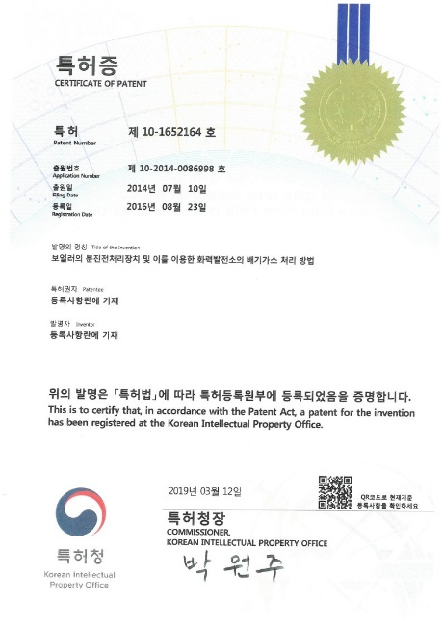
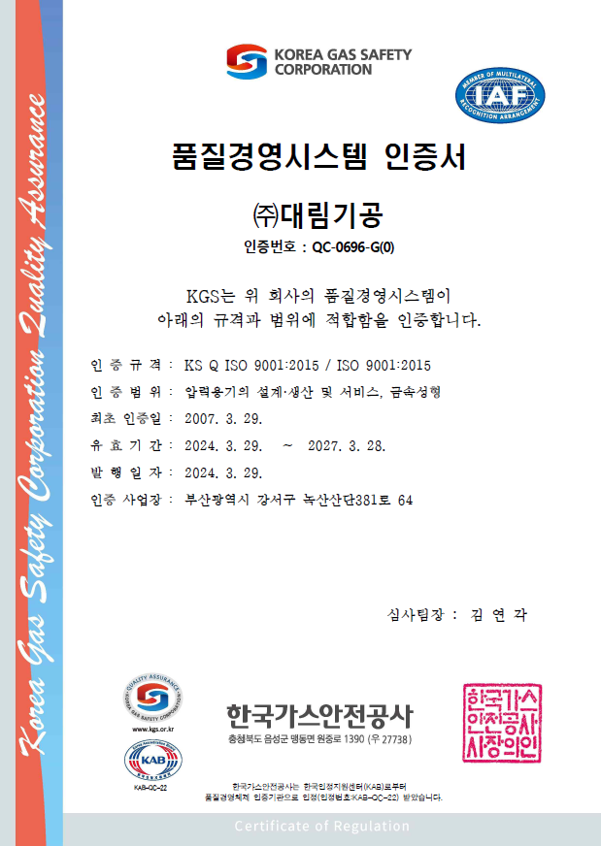
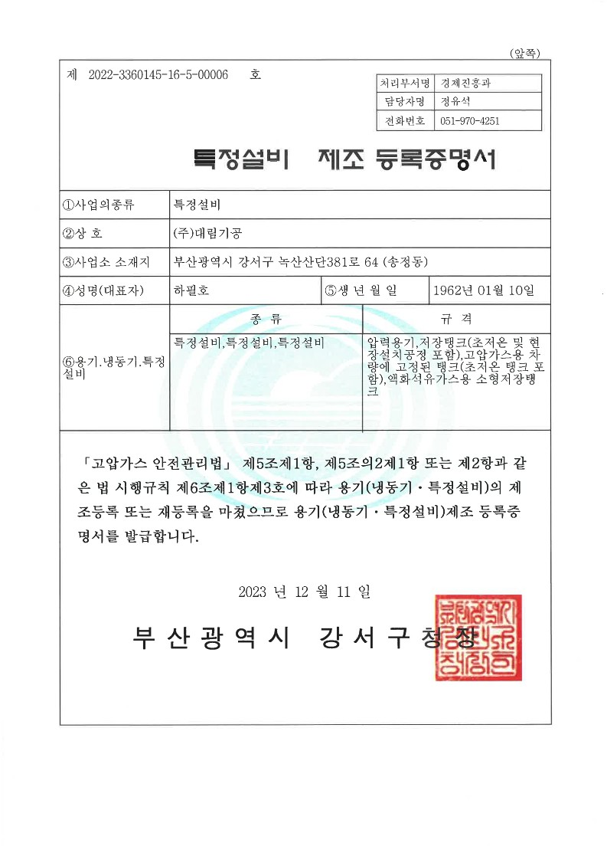
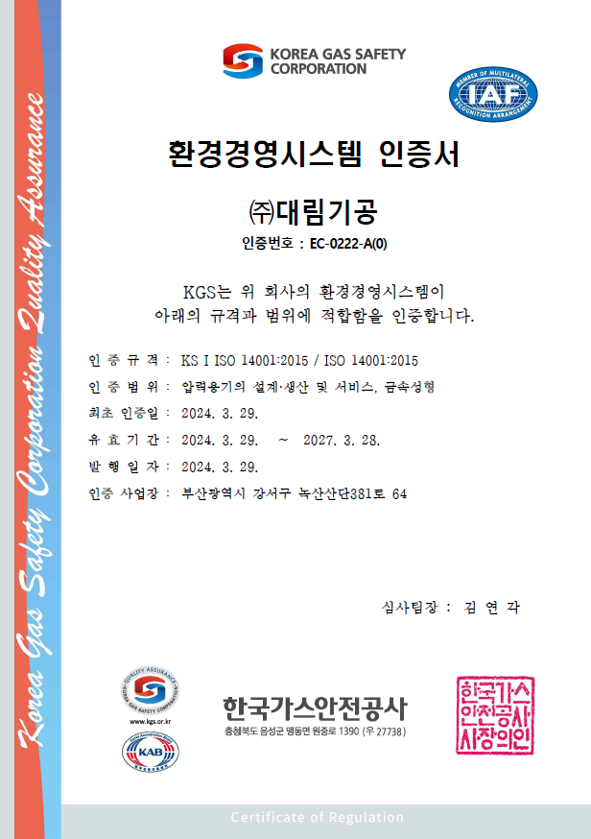
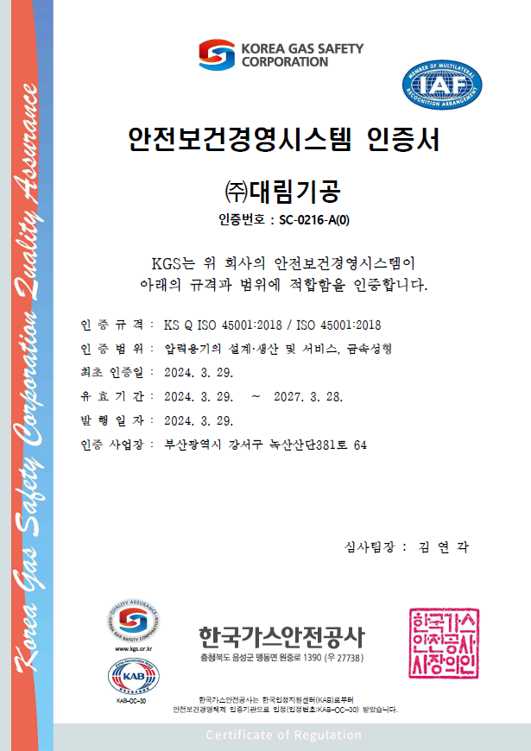
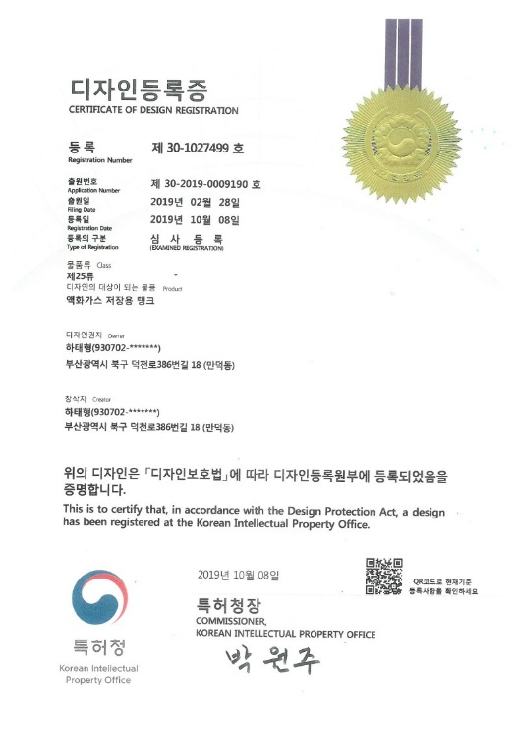
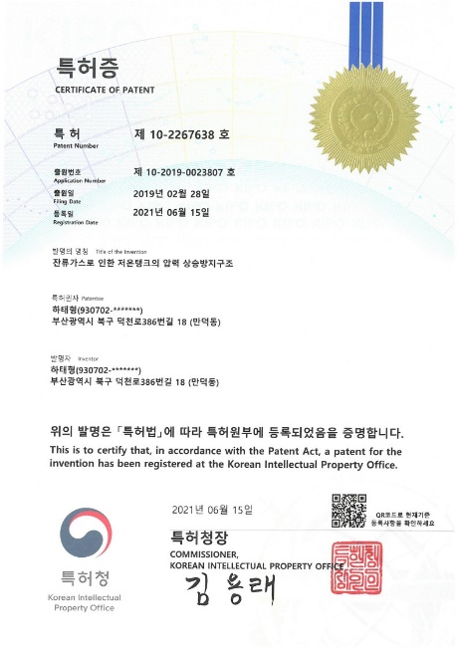
Certification
GENERAL INFORMATION
ASME ( U & U2 ) / Refrigeration facility manufacturing license
ISO 9001, 14001, 45001
07

Slide 12
GENERAL INFORMATION
Production Capacity
Item | Capacity (T/Y)
Cryogenic Storage Tank | 4,000 Ton
Pressure Vessel | 3,500 Ton
Others | 500 Ton
Total | 8,000 Ton
08

Slide 13



GENERAL INFORMATION
Production Allocation
55%
45%
5%
Cryogenic
Storage Tank
Pressure Vessel
Others
09

Slide 14
BUSINESS INFORMATION
Fabrication Capacity (Optimum Size)
Category | Capacity
Handing Capacity(Max) | 7m(W) x 7m(H) x 50m(L) x 500Ton
Thickness Range | 6 ~ 150mm thickness
Shot Blasting / Painting | 15m(W) x 6m(H) x 25m(L)
RT Room | 8m(W) x 8m(H) x 17m(L)
10

Slide 15






















Major Customers
BUSINESS INFORMATION
11

Slide 16
Major Customers
BUSINESS INFORMATION
11

Slide 17
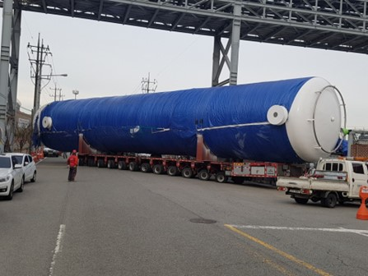
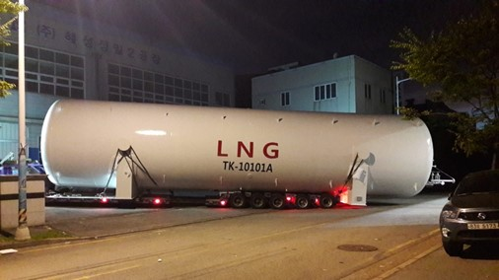
BUSINESS INFORMATION
Experiences
Storage Tank
Storage Tank
Project Name | Hyundai Oil Bank
Size | W5.5m x H6.5m x L27m
Weight | 500m³ LOX Storage Tank (10barg)
Delivery | 2017
Project Name | KOMERI
Size | W4.1m x H5.1m x L32m
Weight | 300m³ LNG Storage Tank (10barg)
Delivery | 2019
12

Slide 18
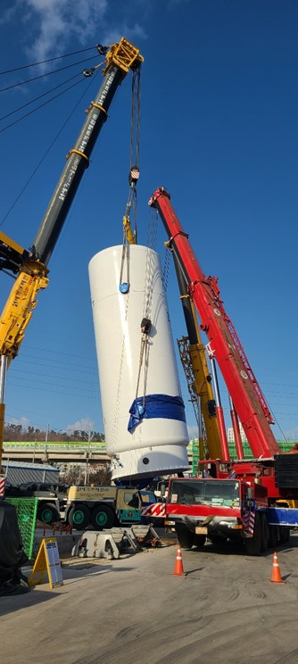
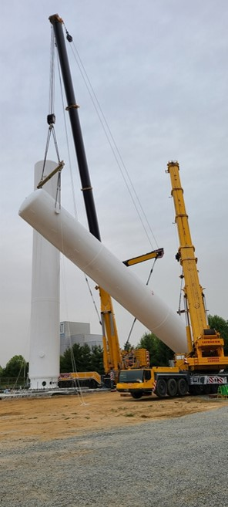
Experiences
Storage Tank
BUSINESS INFORMATION
Project Name | SK materials air plus
Weight | 400ton LCO2 Storage Tank (23barg)
Delivery | 2020
Project Name | ECO PRO, OCHANG
Size | W4.1m x H5.1m x L35m
Weight | 300ton LOX Storage Tank (10barg)
Delivery | 2021
13

Slide 19
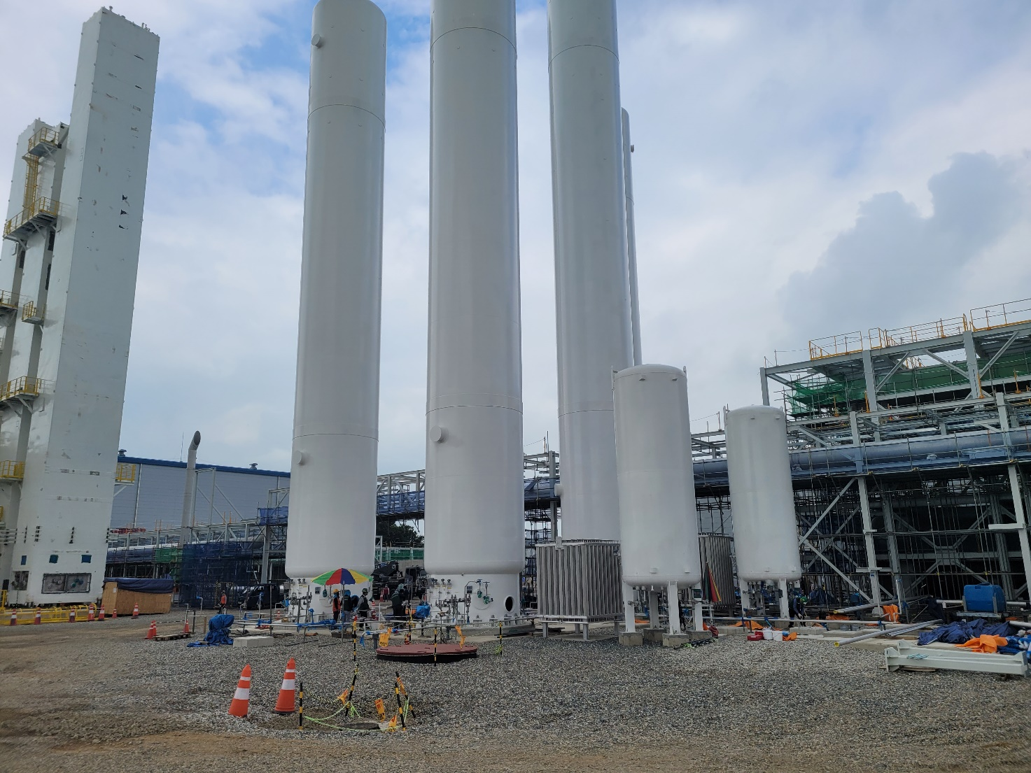
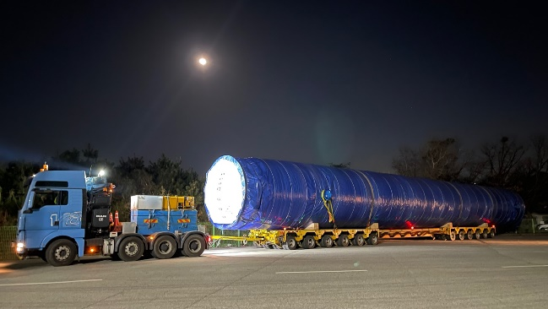
BUSINESS INFORMATION
Experiences
Storage Tank
Project Name | Air First
Size | W4.0m x H5.0m x L38m
Weight | 330m³ Cryo Storage Tank (10barg)
Delivery | 2021
14

Slide 20
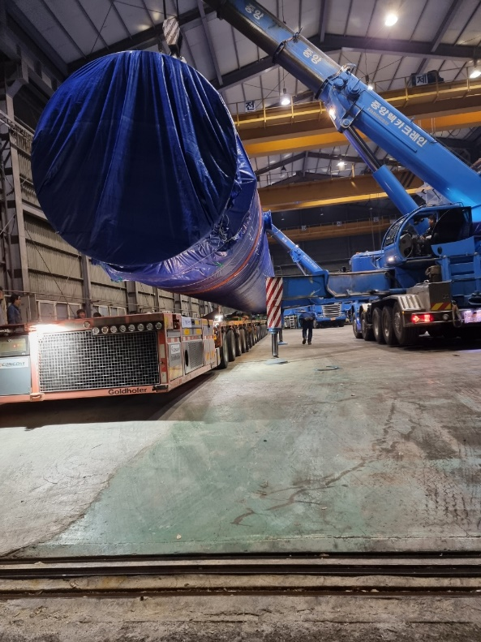
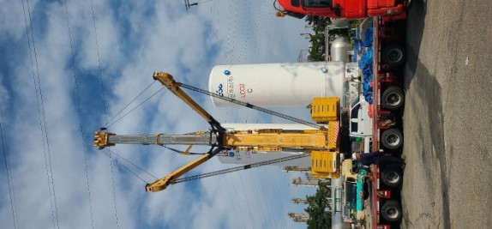
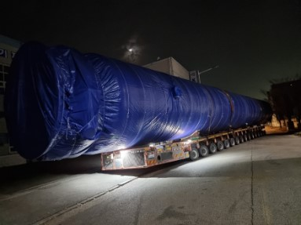
BUSINESS INFORMATION
Experiences
Storage Tank
Project Name | Lotte Chemical / Changshin
Size | W6.6m x H7.6m x L23m
Weight | 500ton LCO2 Storage Tank (23barg)
Delivery | 2023
15

Slide 21
BUSINESS INFORMATION
Experiences
LNG STORAGE TANK 5SETS
Project Name | USA ESNG 380M3 LNG TANK
Size | W5.6m x H5.4m x L28m
Weight | 130 TON
Delivery | 2025
15

Slide 22
BUSINESS INFORMATION
Experiences
LNG STORAGE TANK 4SETS
Project Name | USA Relativity Space 478M3 LNG TANK
Size | W5.8m x H6.2m x L34m
Weight | 163 TON
Delivery | 2025
15

Slide 23
BUSINESS INFORMATION
Experiences
LNG STORAGE TANK 3SETS
Project Name | USA Relativity Space 83M3 LNG TANK
Size | W4.4m x H4.8m x L11.2m
Weight | 47 TON
Delivery | 2025
15

Slide 24

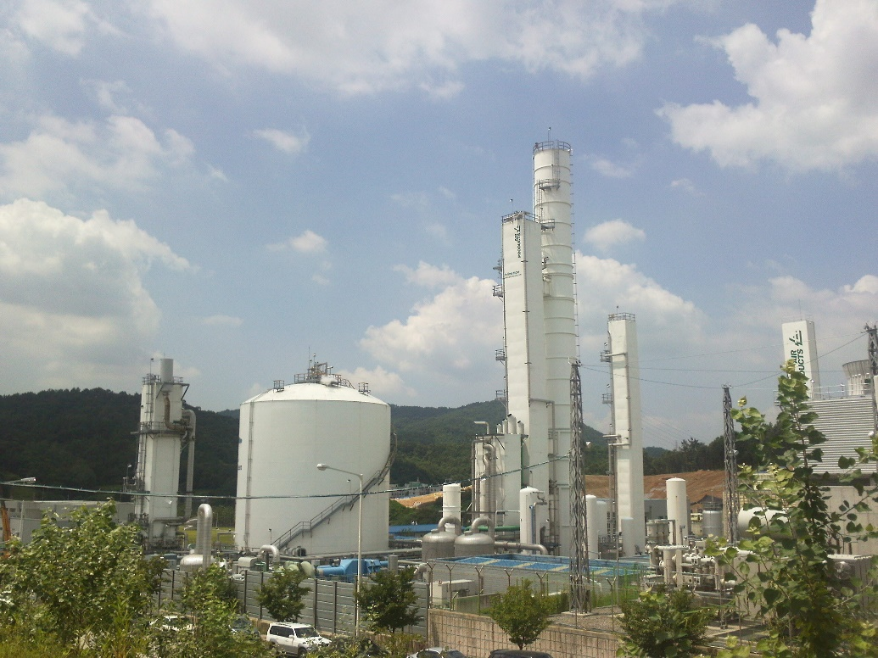
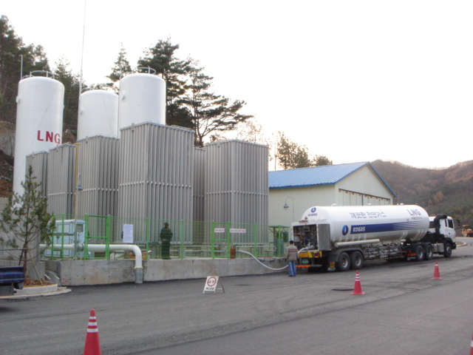
Experiences
BUSINESS INFORMATION
Complex Charging Equipment CO2
Nugget(dry-ice) System
ASU PLANT
20,000Nm3/hr LNG Satellite
16

Slide 25
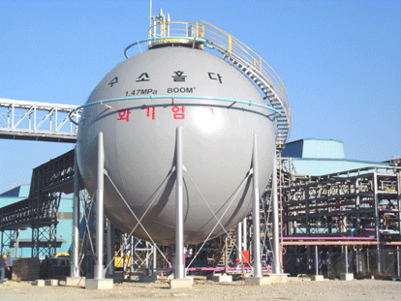

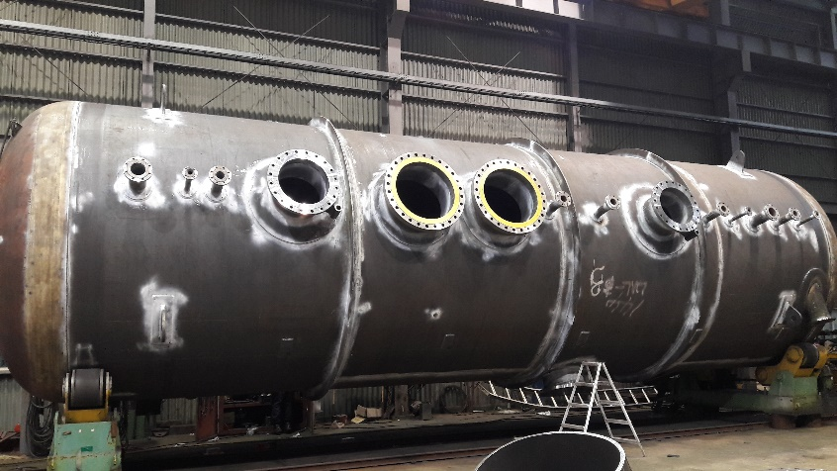
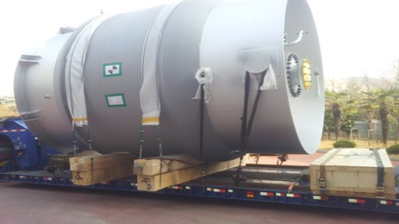
BUSINESS INFORMATION
Experiences
H2 GAS HIGH PRESS STORAGE TANK
METAL CHLORIDE STORAGE TANK
SICON TETRACHLORIDE STORAGE TANK
CHLOROSIANES STORAGE TANK
17

Slide 26
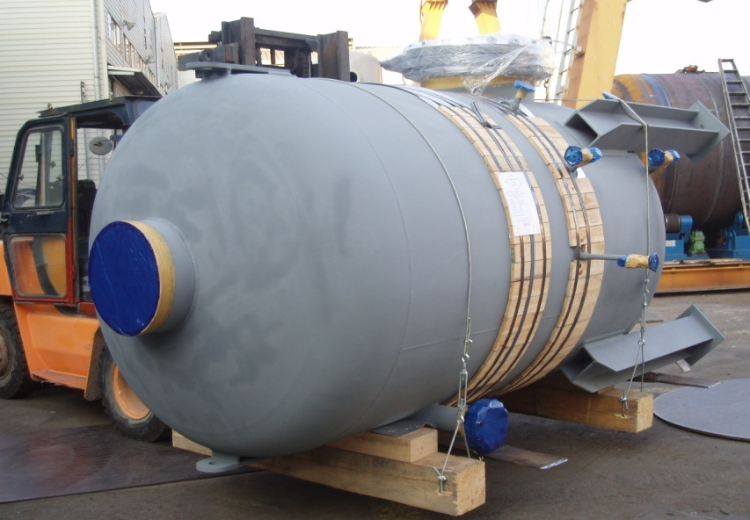
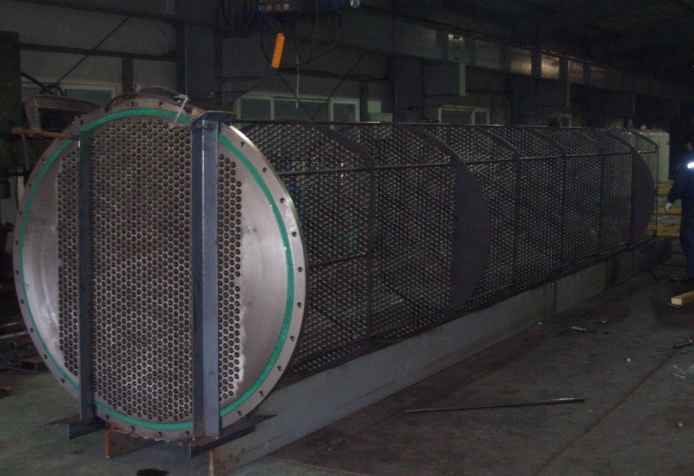
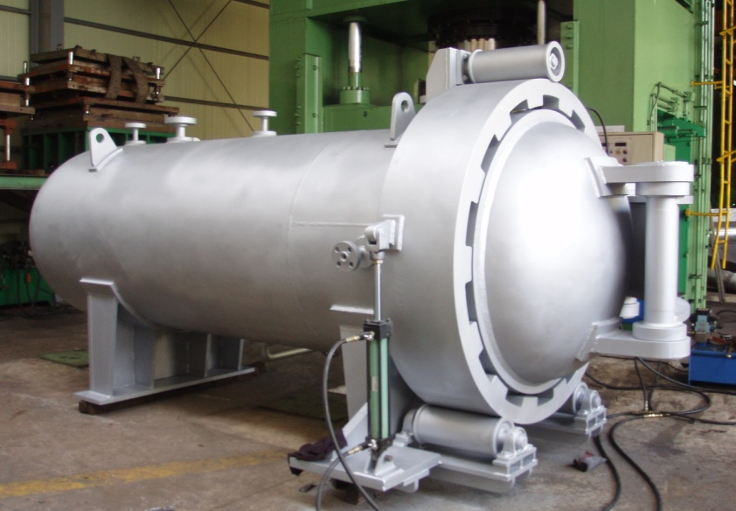
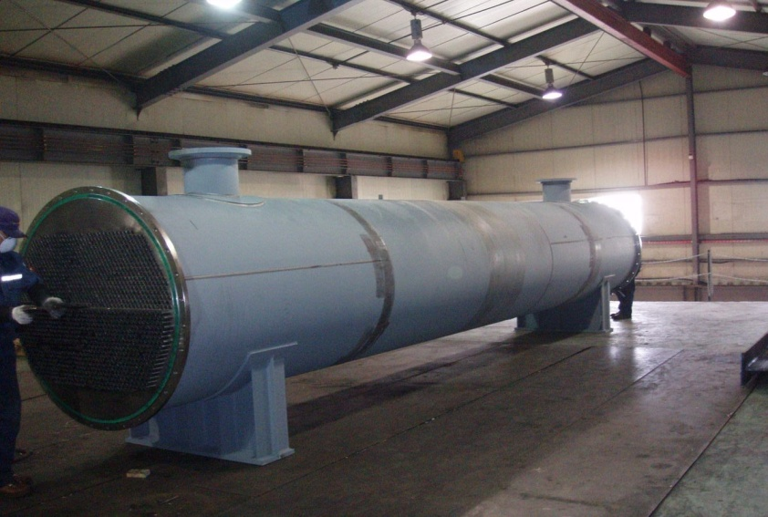
BUSINESS INFORMATION
Experiences
HEAT EXCHANGER, VESSEL& AUTO CLAVE
18

Slide 27
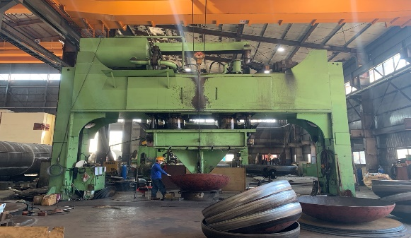
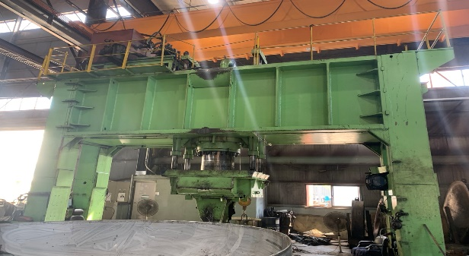
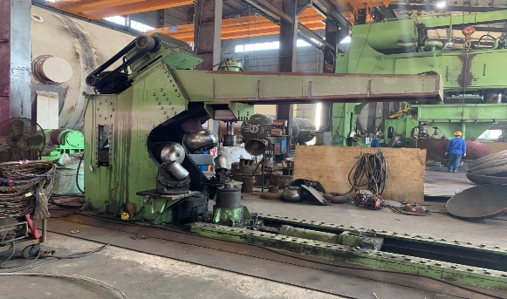
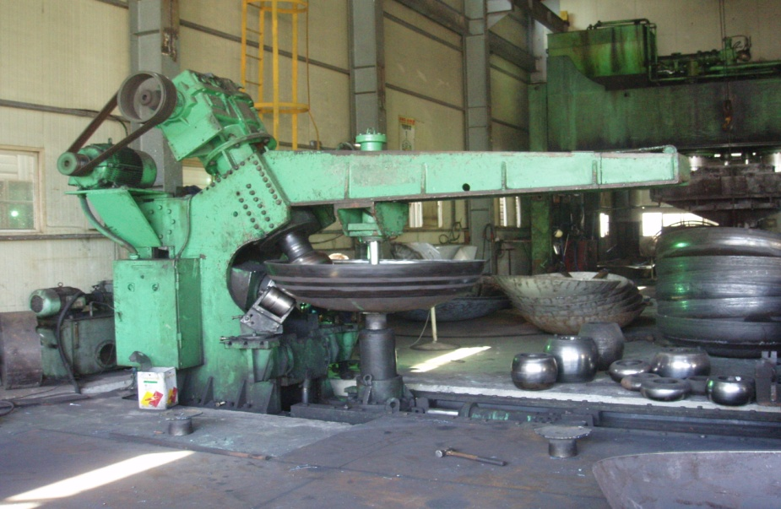
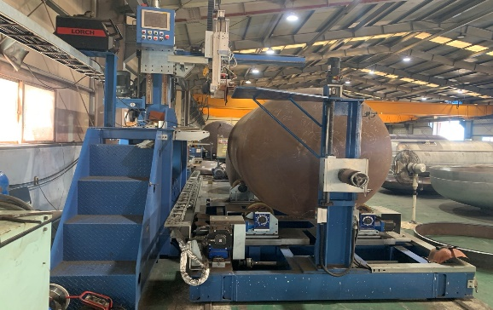
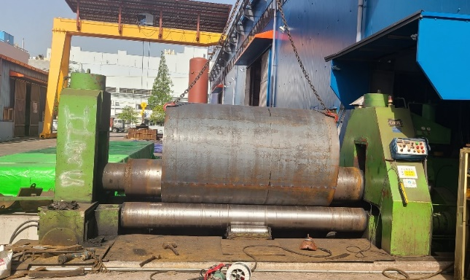
BUSINESS INFORMATION
PRODUCTION EQUIPMENT (1/2)
Forming Press
(2,000ton)
Forming Press
(2,000ton)
Spinning Machine
(Max. 20t x Ø3000)
Spinning Machine
(Max. 50t x Ø6000)
Auto Welding
Machine
Bending Machine
(Max. 65t x 4000width)
19

Slide 28
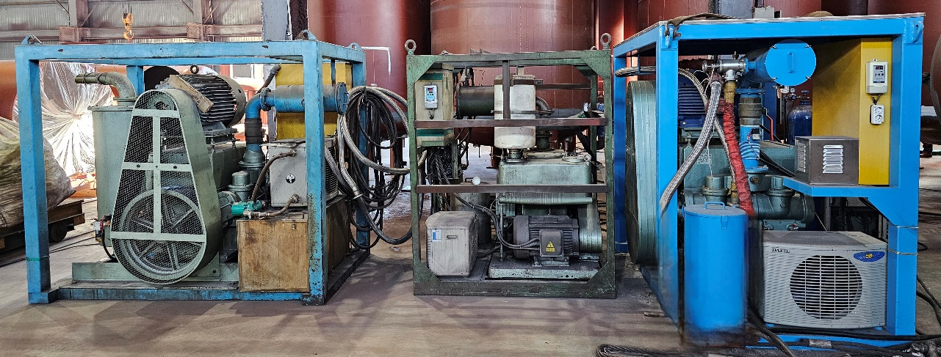
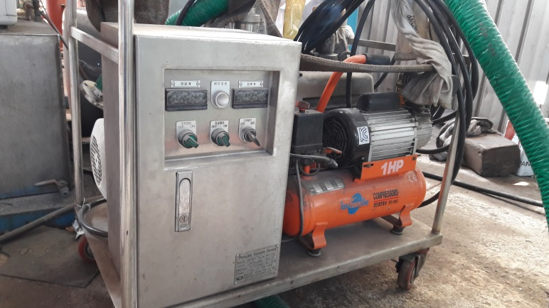
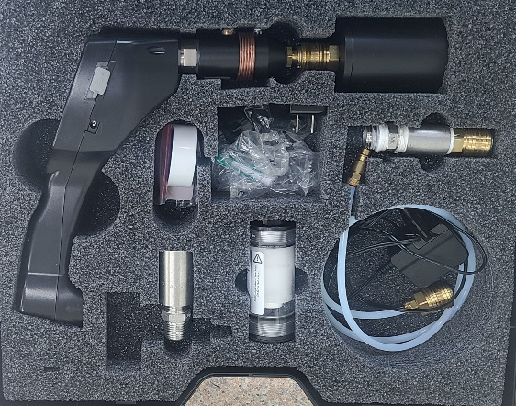


BUSINESS INFORMATION
PRODUCTION EQUIPMENT (2/2)
Vacuum Pump (about 35sets)
Helium Leak Tester
Flow Meter (Wet Type)
Dew Point Tester
20

Slide 29



HSE (Health, Safety and Environment)
21

Slide 30
SUPPLY RECORDS
Cryogenic Storage Tank
No | Product | Q’ty | Customer | Remarks
1 | 100m3 LN2 TANK | 2 | AIR WATER INC. | JAPAN
2 | 250m3 LO2 TANK | 1 | AIR WATER INC. | JAPAN
3 | 120m3 LNG TANK | 1 | Energy management Agency
4 | 150m3 LN2 TANK | 1 | AIR WATER INC.
5 | 150m3 LN2 TANK | 2 | MATSUYAMA SANSO | JAPAN
6 | 5295m3 LO2 TANK, PRE-FABRICATION | 1 | WINTECO | SAUDI ARABIA
7 | 6612m3 LN2 TANK, PRE-FABRICATION | 1 | WINTECO | SAUDI ARABIA
8 | 385m3 LAr TANK | 2 | WINTECO | SAUDI ARABIA
9 | 120m3 LNG TANK | 2 | MS ENG Co.,LTD
10 | 80m3 LNG TANK | 1 | TONG YANG Co,LTD
11 | 150m3 LNG TANK | 1 | Gasload Co.,LTD | ADD
22

Slide 31
SUPPLY RECORDS
Cryogenic Storage Tank
No | Product | Q’ty | Customer | Remarks
12 | 100m3 LN2 TANK | 2 | DANIL GASCHEM
13 | 450m3 LO2 TANK | 1 | APK | HYUNDAI
14 | 220m3 LNG TANK | 2 | MS ENG | YOUJIN CHEMICAL
15 | 330m3 LN2 TANK | 1 | AIR FIRST | HANTECH
16 | 330m3 LO2 TANK | 3 | AIR FIRST | HANTECH
17 | 280m3 LAR TANK | 2 | AIR FIRST | HANTECH
18 | 328m3 Cryogenic Tank | 4 | DANIL GASCHEM | ECO PRO, OCHANG
19 | 300m3 LNG Cryogenic Tank | 1 | JEONGWOO ENERGY | KOMERI
20 | 400m3 LCO2 Cryogenic Tank | 1 | SK materials
21 | 300ton LO2 TANK | 2 | DANIL GASCHEM | ECO PRO, POHANG
22 | 100ton LN2 TANK | 1 | DANIL GASCHEM | ECO PRO POHANG
23 | 310m3 Cryogenic Tank | 1 | DANIL GASCHEM
23

Slide 32
SUPPLY RECORDS
Cryogenic Storage Tank
No | Product | Q’ty | Customer | Remarks
24 | 500ton LCO2 Storage Tank | 6 | CHANGSHIN CHEMICAL | LOTTE CHEMICAL
25 | 338m3 LN2 TANK | 2 | AIR FIRST | GUNSAN STAR
26 | 222m3 Lar TANK | 1 | AIR FIRST | GUNSAN STAR
27 | 380m3 Horizontal LNG Tank (USA) | 5 | ESNG Bishopville Project | 2025
28 | 478m3 Horizontal LNG Tank (USA) | 4 | Relativity 1st Project | In Progress
29 | 197m3 Vertical LNG Tank (USA) | 2 | Relativity 2nd Project | In Progress
30 | 83m3 Vertical LNG Tank(USA) | 3 | Relativity 2nd Project | In Progress
31 | 500ton LCO2 LNG Tank | 2 | Coupang | 2025
30 | 500ton LCO2 LNG Tank | 2 | Changshin Gas | In Progress
** Standard Cryogenic Tank per every year for Gas Plant = 250 sets
24

Slide 33
We are making also
the best quality & keep delivery with reasonable price !
Thank you !
Q & A ?

